Slide 1
Courage That Drives
Profitable Growth
Presented By James B. Jenkins, CPCU, CIC, CRM

Slide 2
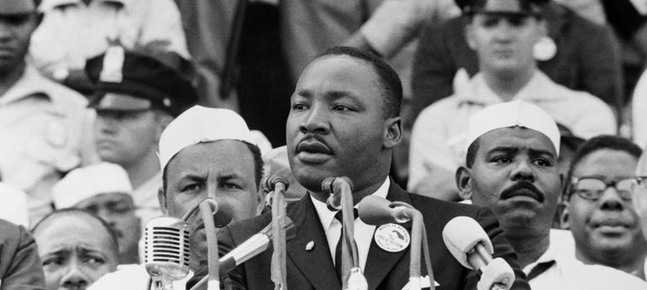
Credit: Getty Images

Slide 3
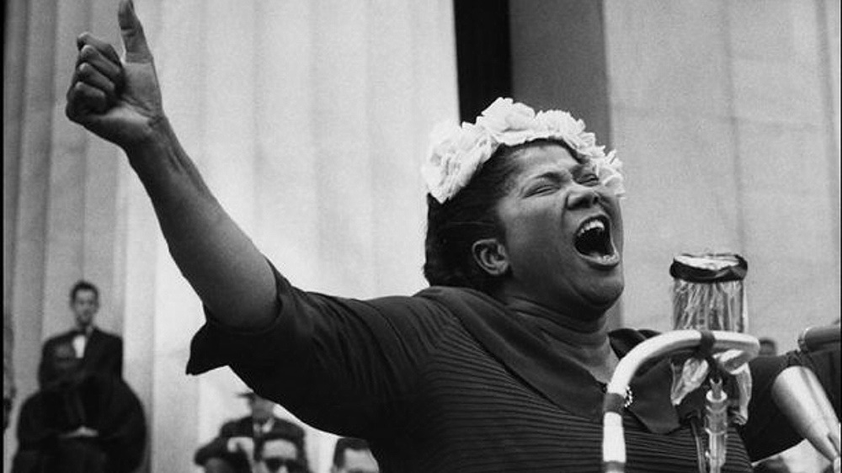

Slide 4
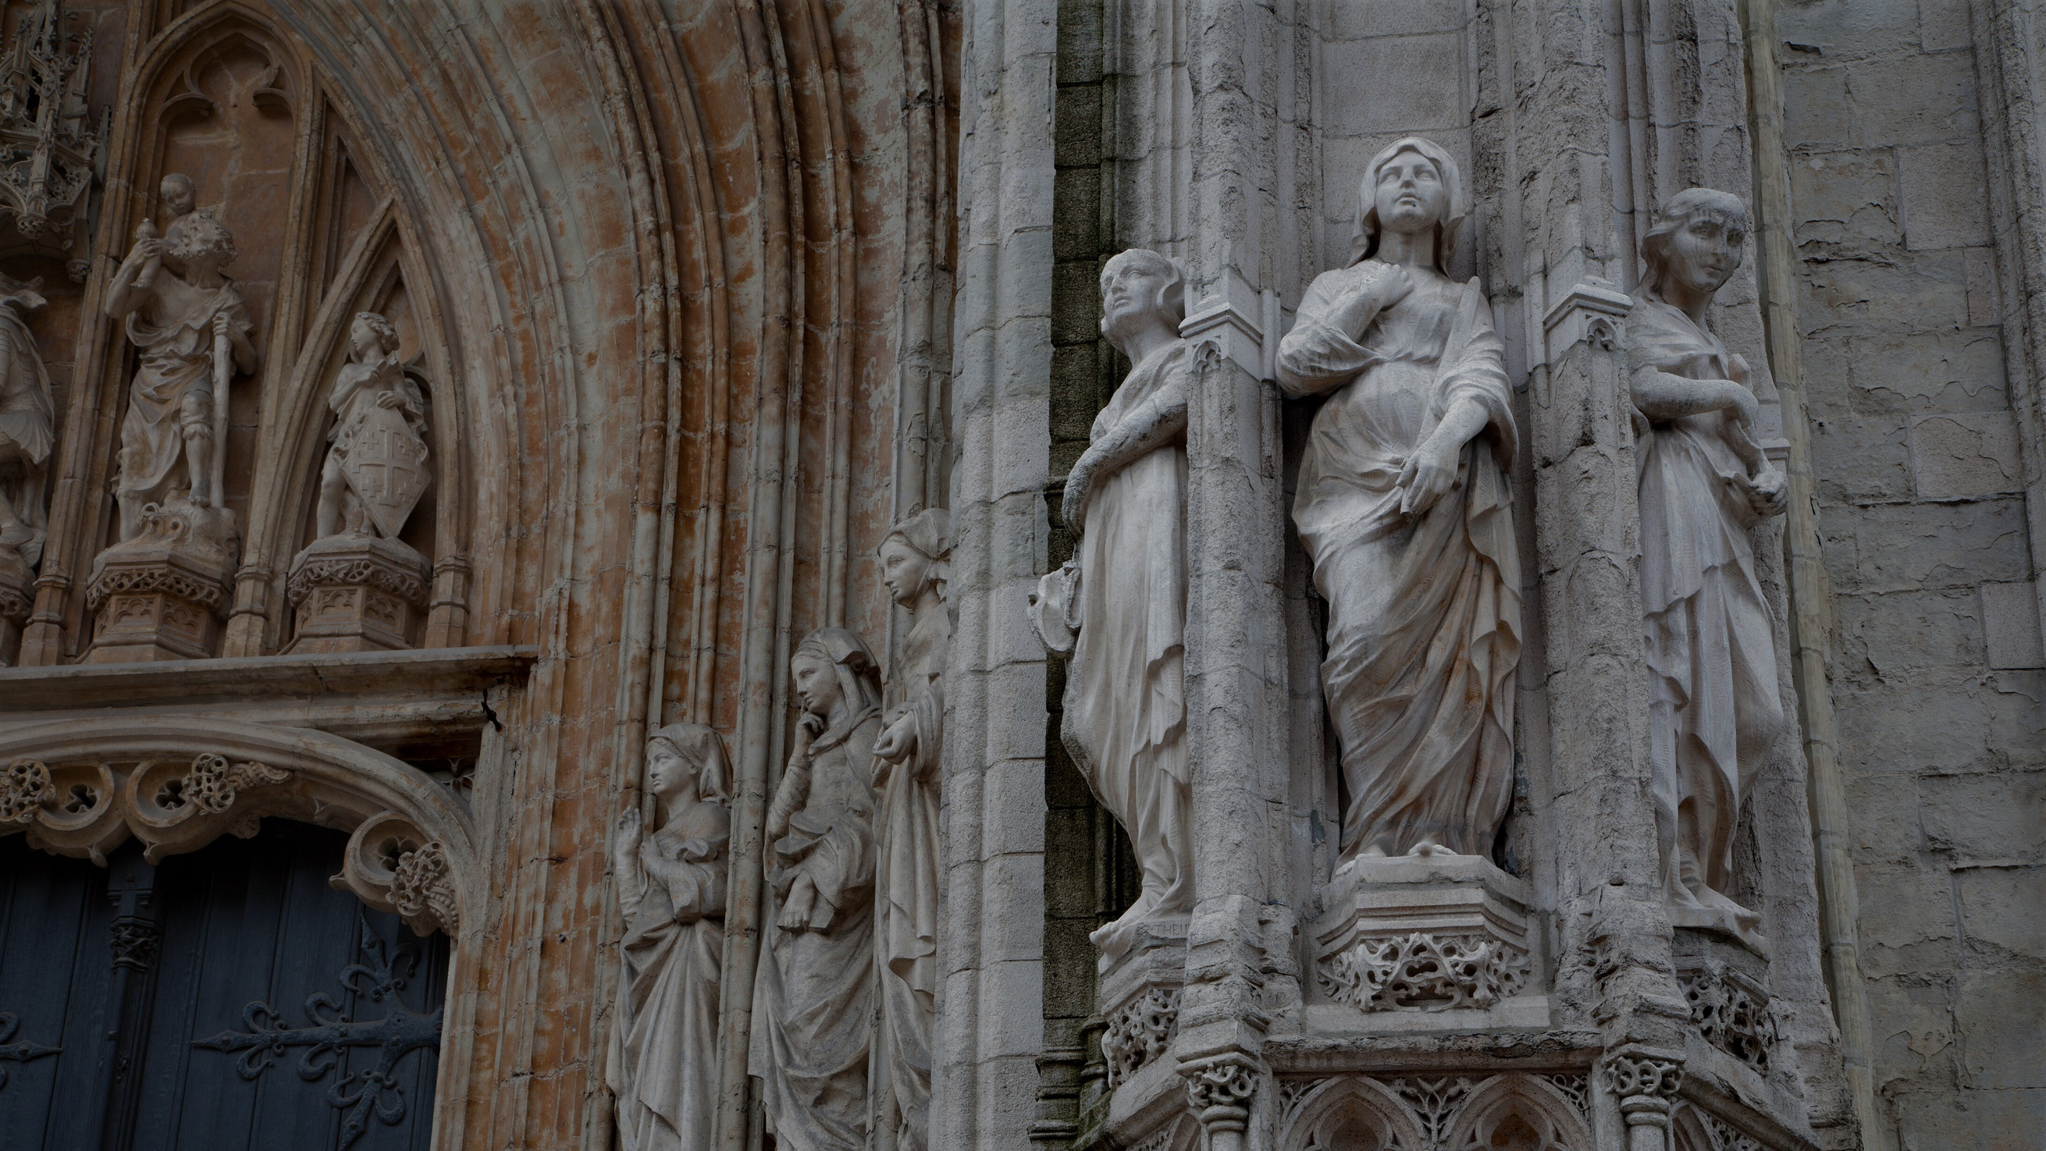
Wisdom
Temperance
Justice
Courage

Slide 5
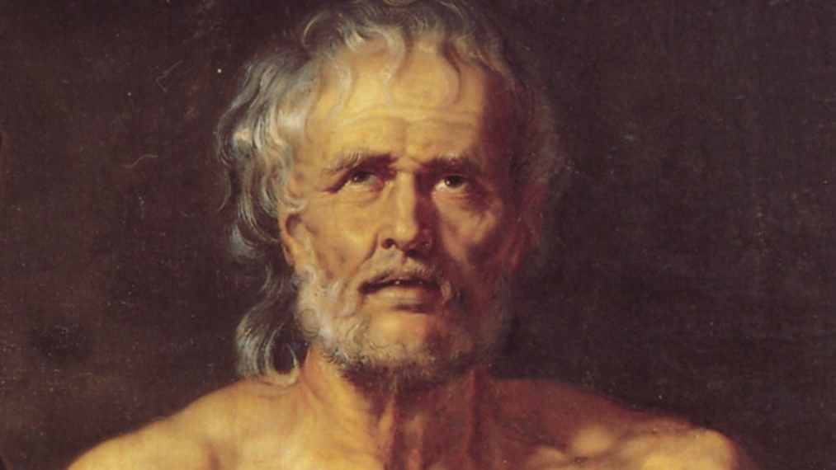

Slide 6
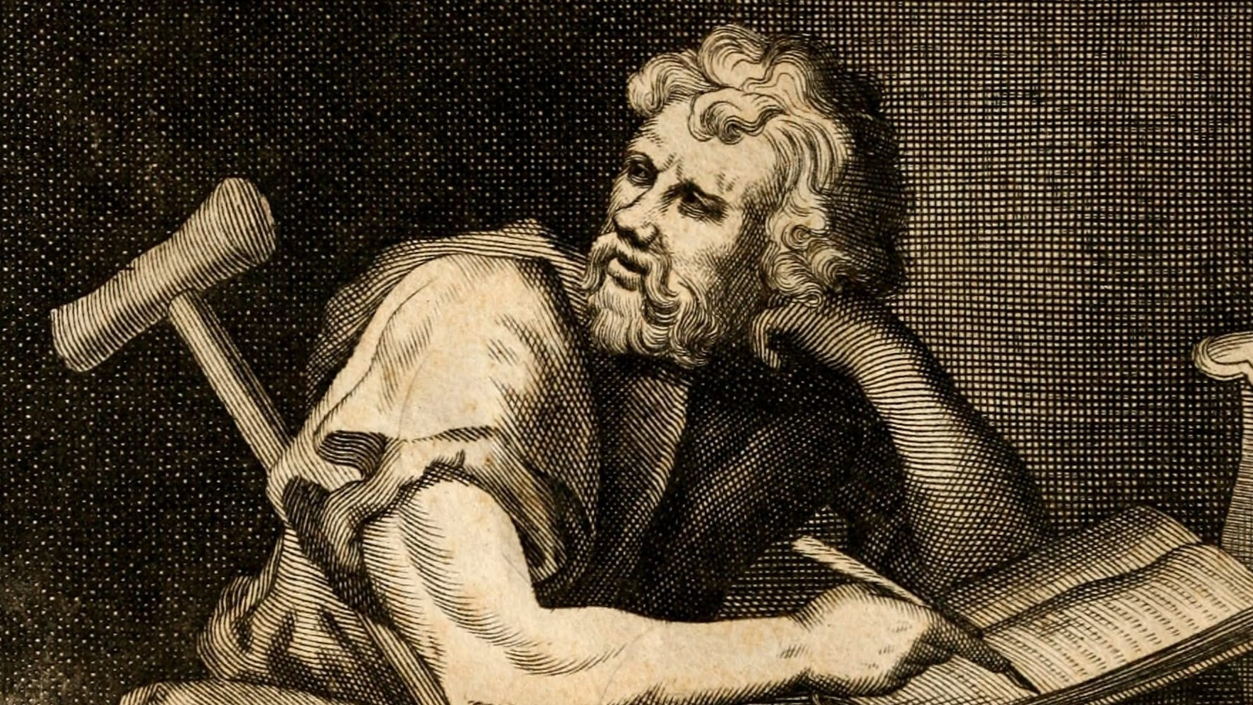

Slide 7
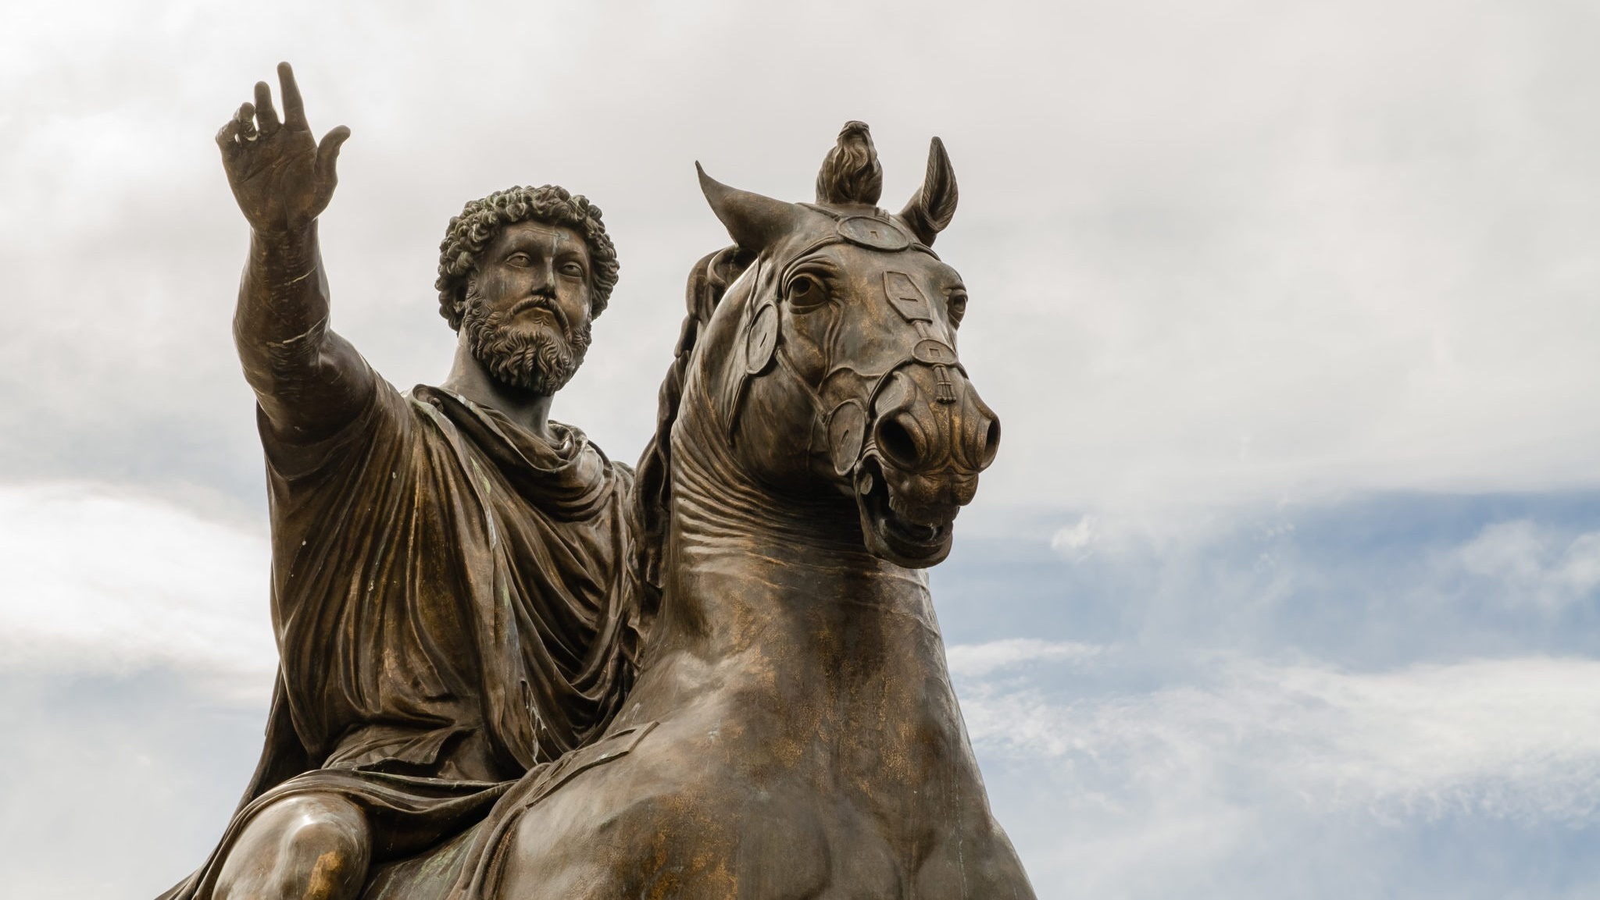
Credit: Davide Trolli

Slide 8

Credit: Getty Images

Slide 9

Here’s Where We’re Going

Slide 10

what hard market?

Slide 11

Align

Slide 12

I Don’t Care

Slide 13
Je m’en fiche

Slide 14


Slide 15

Alignment
=
Attraction

Slide 16

Be

Slide 17

Need
Want

Slide 18

What Is
Holding
You
Back?

Slide 19

Care
Less

Slide 20


Slide 21


Slide 22
Courage
Fear
Paradox

Slide 23







SHARE FEEDBACK WITH JAMES
1.Scan this QR code
2. Enter this code on the screen
SPARK
Let's stay in touch!
@riskwell @thejamesjenkins

