Slide 1
The ABCs Of Recruiting And Growing Great ISMs
Presented By James B. Jenkins,
CPCU, CIC, CRM

Slide 3
Here’s Where We’re Going Together

Slide 4
ATTRACT

Slide 5
The Herd Is Safe

Slide 8
Credit: Lucasfilm LTD

Slide 9
Credit: Lucasfilm LTD

Slide 11
“Do you mind if I
ask you a question?”

Slide 12
“How are you currently
handling ________?”

Slide 13
“What’s your plan for
when ________ happens?”

Slide 14
“How did ________
effect your office?”

Slide 16
Option 1: The Captive Agency
11.5% Average Commission
18% Closing Rate
What’s the revenue from 100 prospects?

Slide 17
$6,264

Slide 18
Option 2: The IA Agency
13.6% Average Commission
70% Closing Rate
What’s the revenue from 100 prospects?

Slide 19
$29,376

Slide 20
468%

Slide 21
Loser

Slide 22
Principled
Hungry
Smart

Slide 23
Build

Slide 25
RevOps
01
02
03
04
Sales
Marketing
Operations
Back Office

Slide 26
Essentials
Financial Literacy
SWOT Analysis
Quarterly and Annual Meetings

Slide 27
The Pro Forma Mindset

Slide 28
Challenge

Slide 29
Remember What They
Are Missing

Slide 30
Reverse Engineering Goals
From Daily Activities

Slide 31
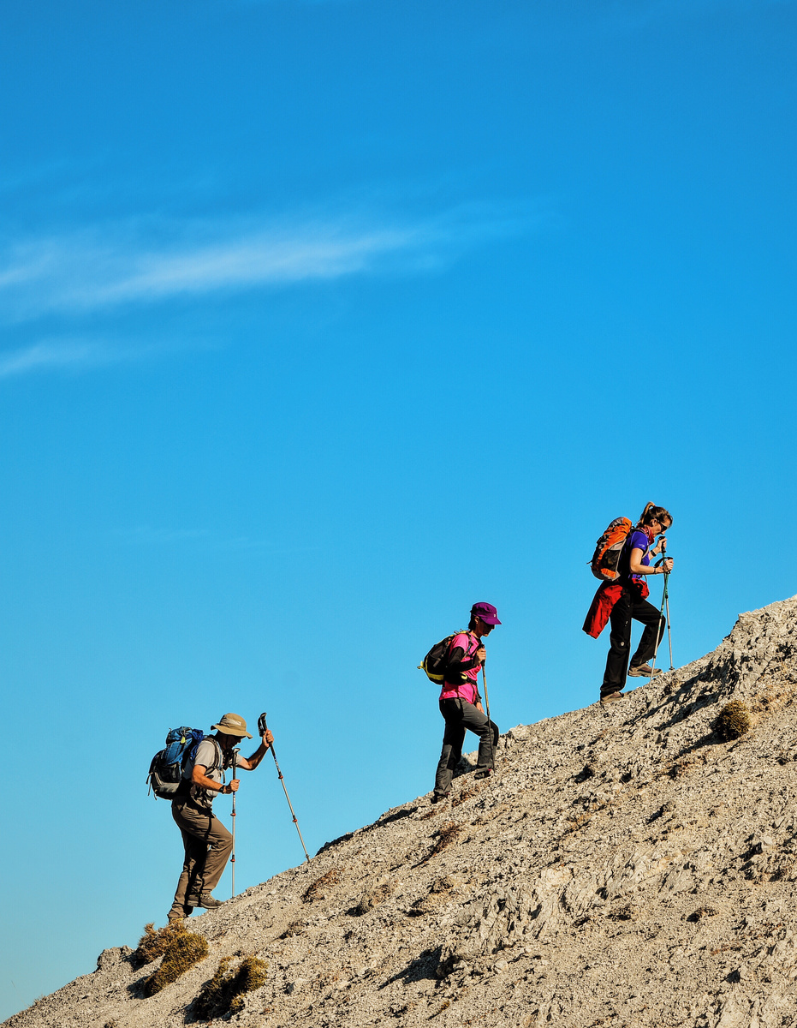
Growth
VS
Lifestyle

Slide 32
“What are you focused on
improving this quarter?”

Slide 33
“What new ideas are you
testing this month?”

Slide 34
“What changes are you
making from lessons
learned last quarter?”

Slide 35
Attract
Build
Challenge

Slide 36
GIVE FEEDBACK TO JAMES
1.Scan this QR code
2. Enter this code on the screen
SIAA
Let's stay in touch!
@riskwell @thejamesjenkins

